Slide 1
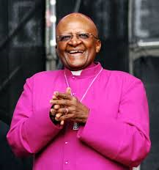
Who is Desmond Tutu?

Slide 2
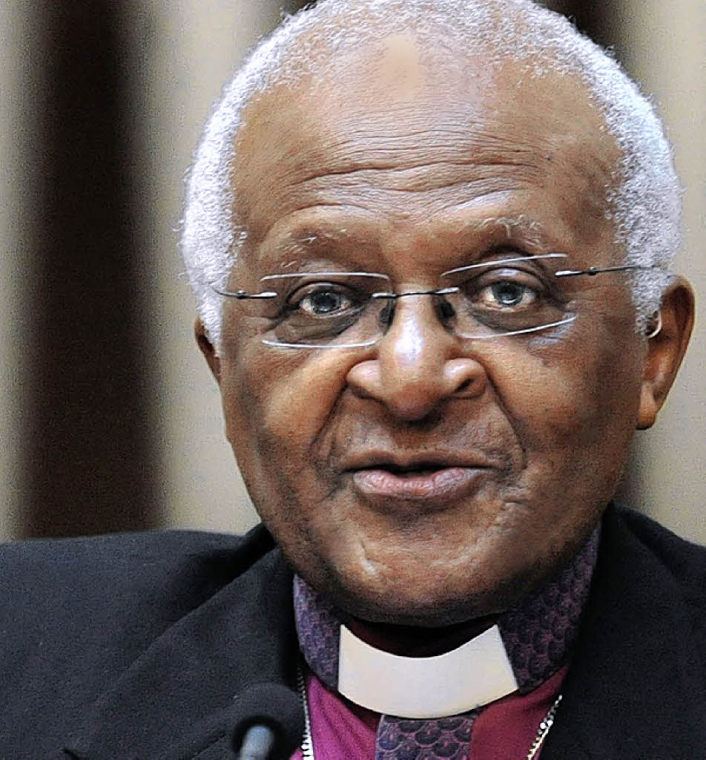
Desmond Tutu
Full name- DESMOND MPILO TUTU
South African social rights activist and retired Anglican bishop who rose to worldwide fame during the 1980s as an opponent of apartheid.
Born: October 7, 1931 (age 84), Klerksdorp, South Africa
Spouse: Nomalizo Leah Shenxane (m. 1955)
Children: 5 children

Slide 3
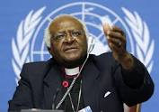
AWARDS
Nobel Peace Prize
Presidential Medal of Freedom

Slide 4
Quotes from Desmond Tutu
Do your little bit of good where you are; it's those little bits of good put together that overwhelm the world.
My humanity is bound up in yours, for we can only be human together.
You don't choose your family. They are God's gift to you, as you are to them.

